Slide 1
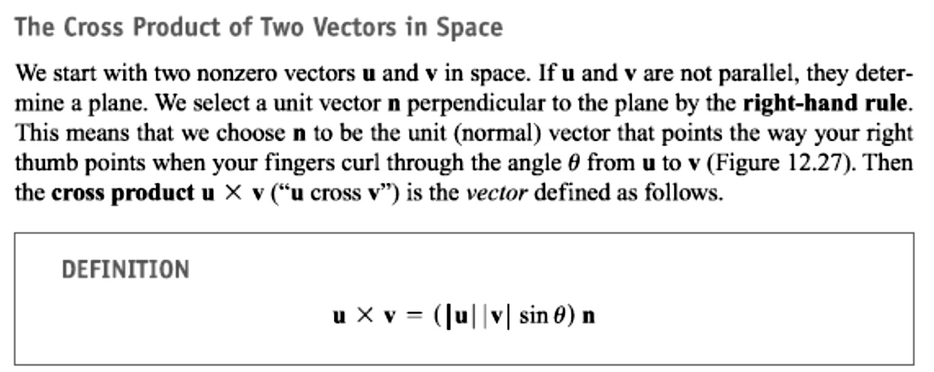
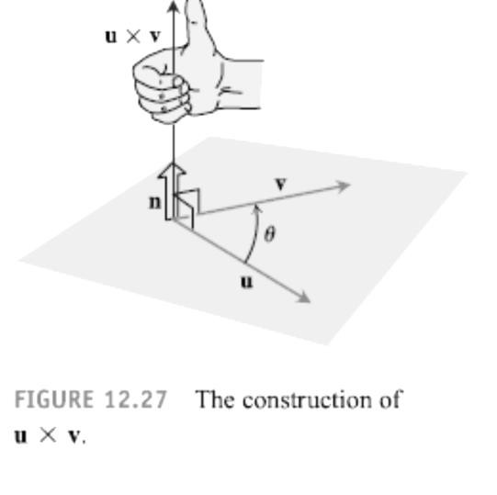
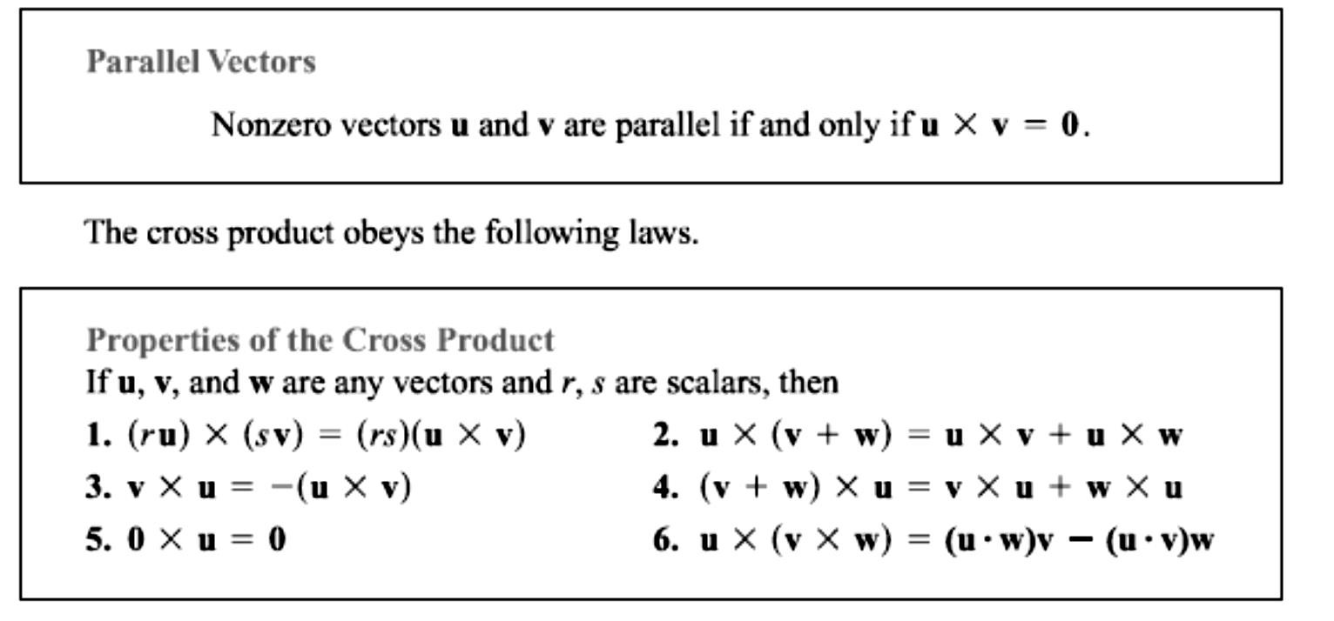
13 / Dep. Of Engineering Mechanics
Class: 2th AMTHMATICS / The vector

Slide 2
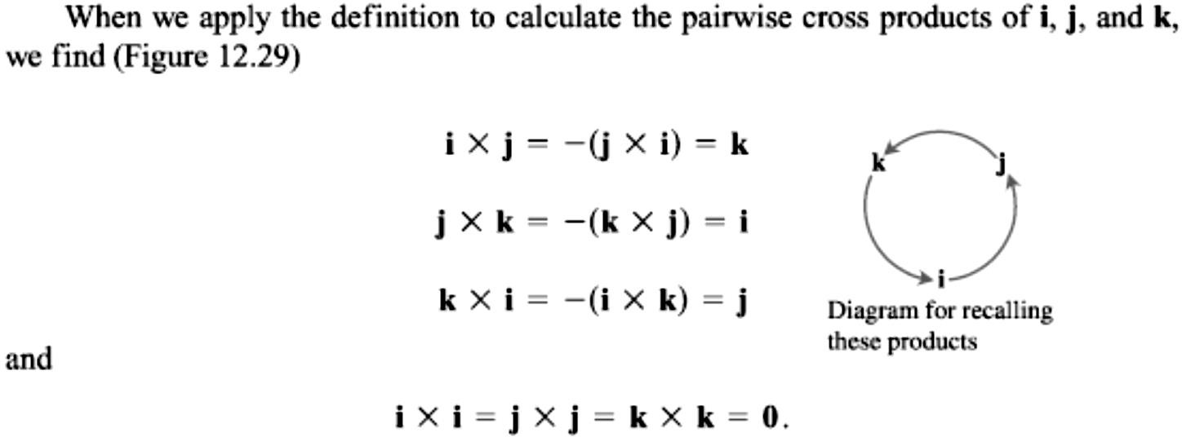
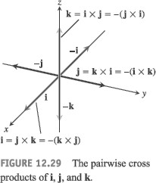
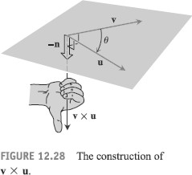
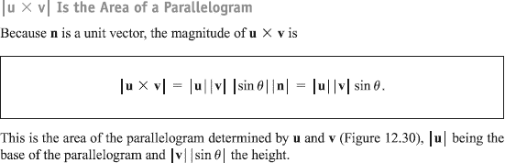
14 / Dep. Of Engineering Mechanics
Class: 2th AMTHMATICS / The vector

Slide 3
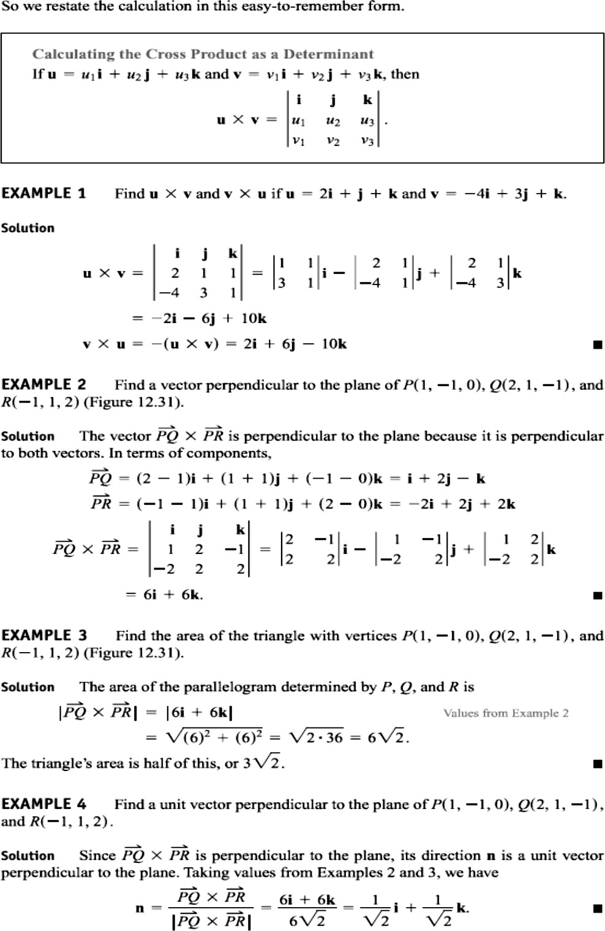
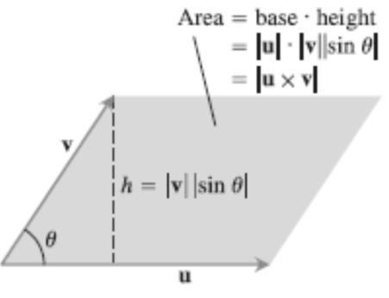
15 / Dep. Of Engineering Mechanics
Class: 2th AMTHMATICS / The vector

Slide 4
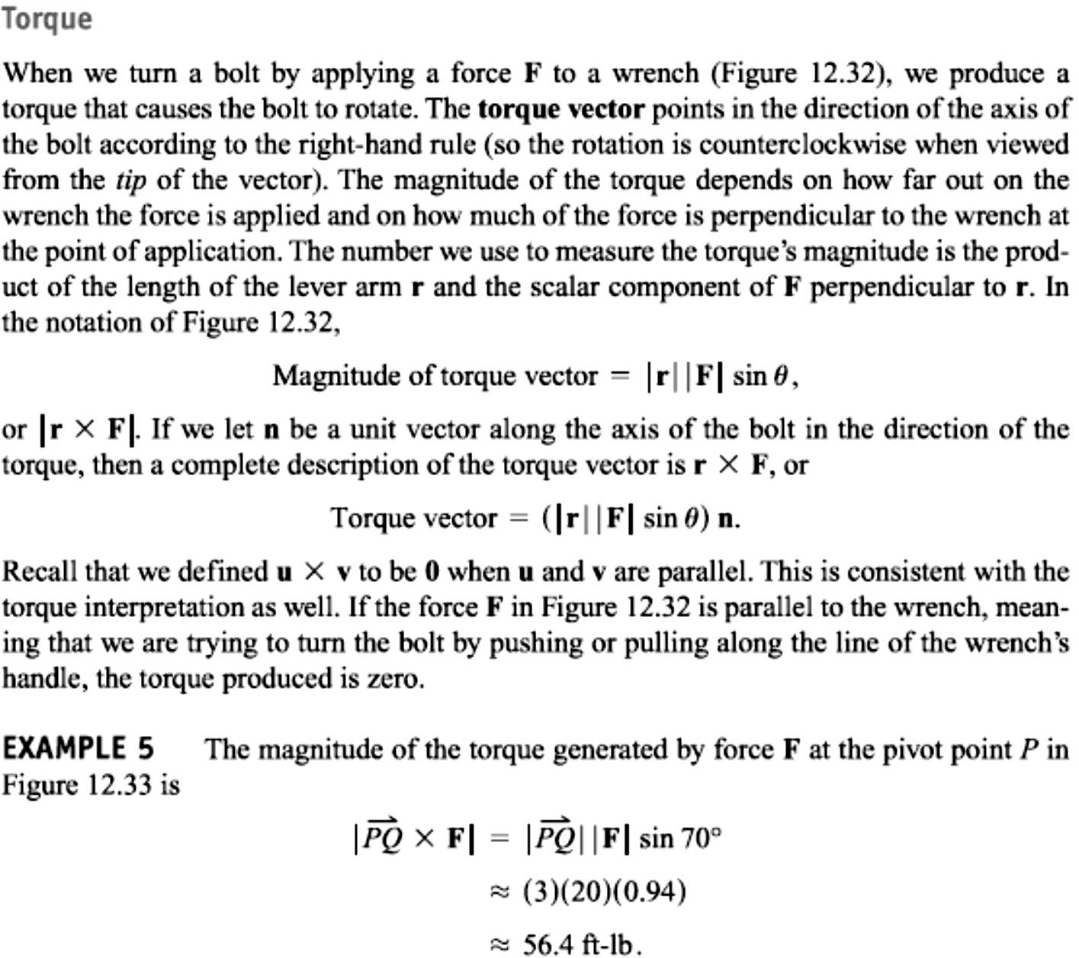
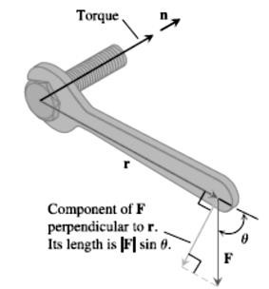
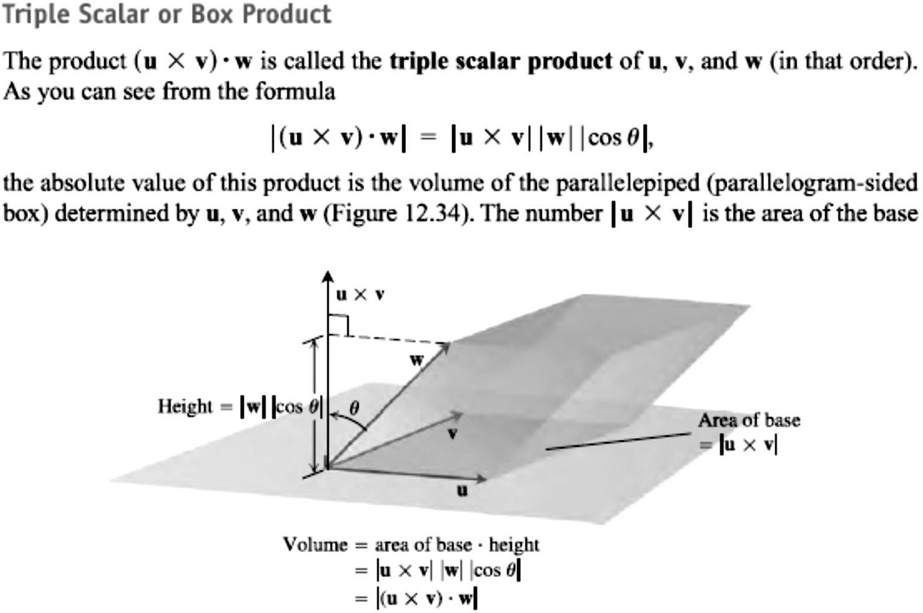
16 / Dep. Of Engineering Mechanics
Class: 2th AMTHMATICS / The vector

Slide 5
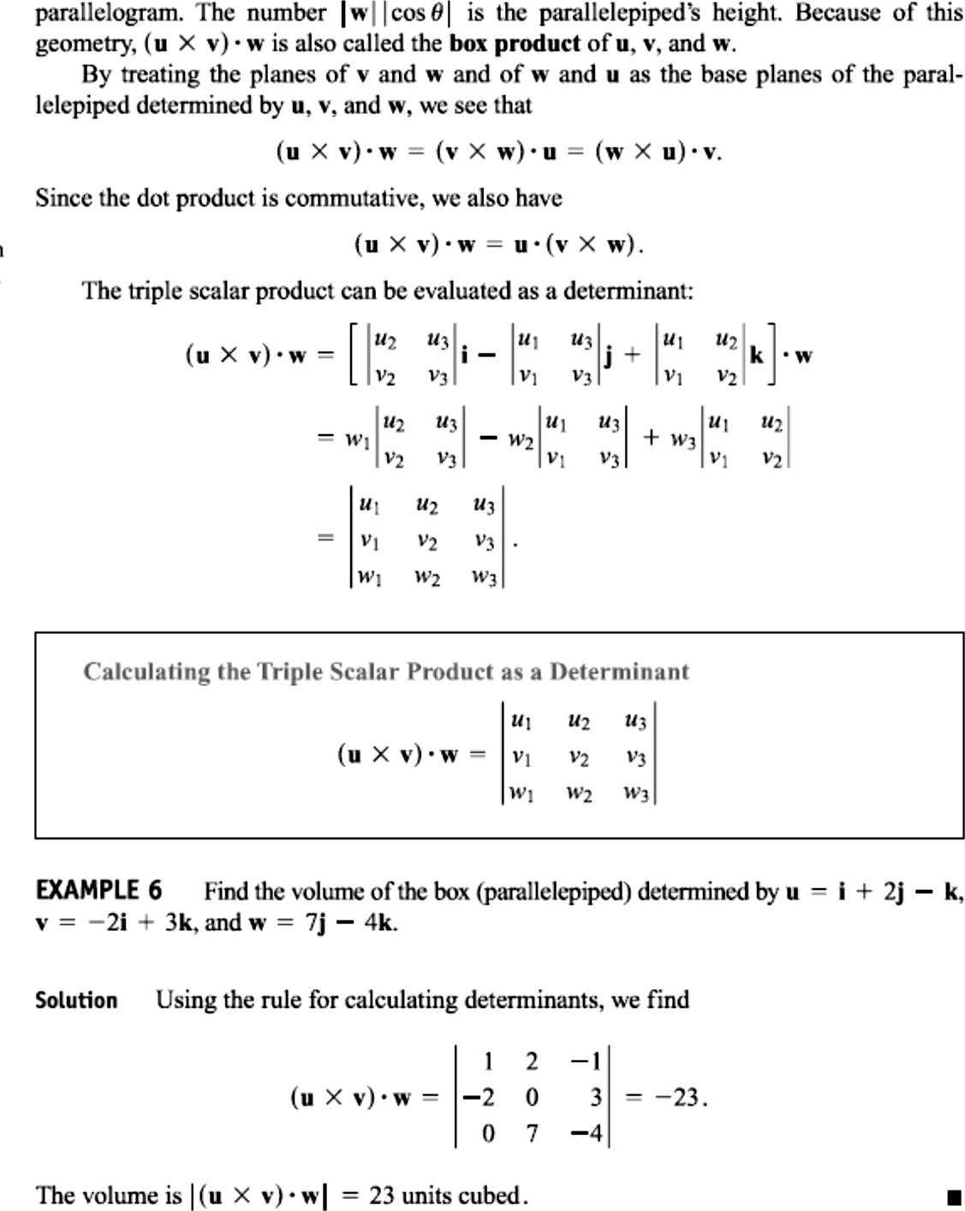
17 / Dep. Of Engineering Mechanics
Class: 2th AMTHMATICS / The vector

Slide 6
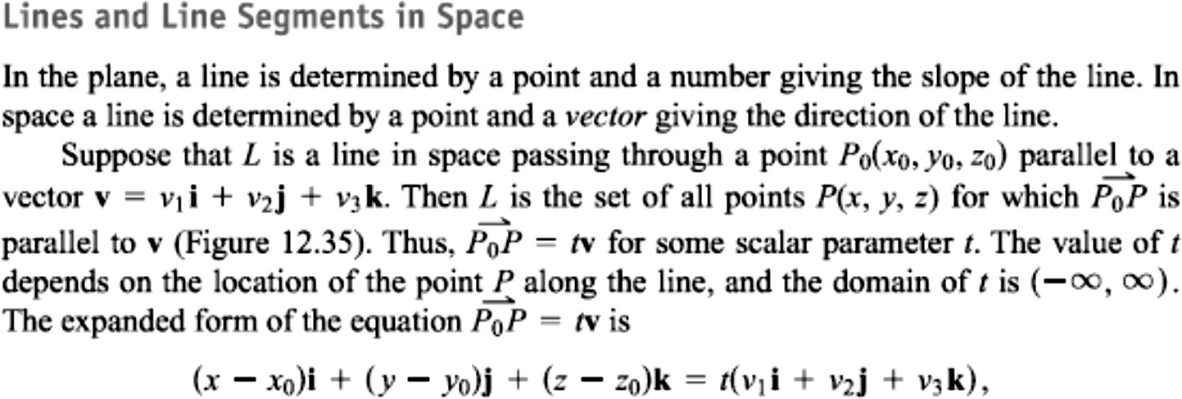
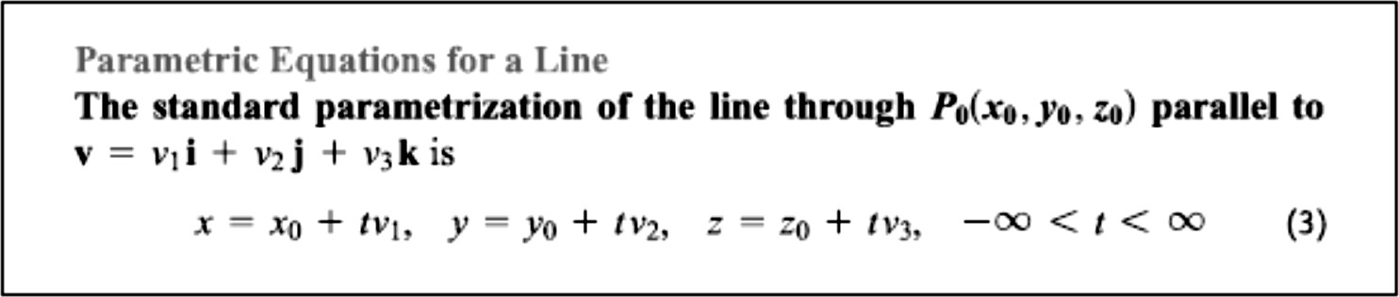
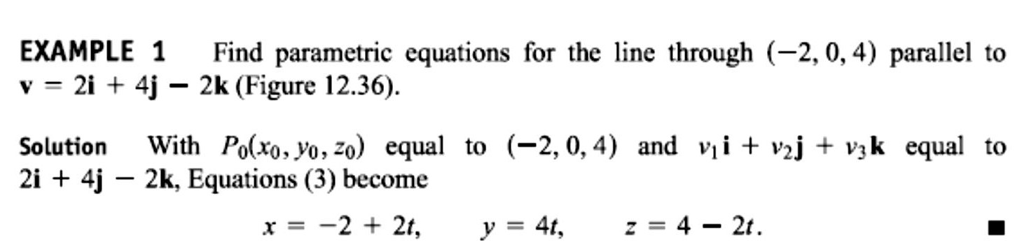
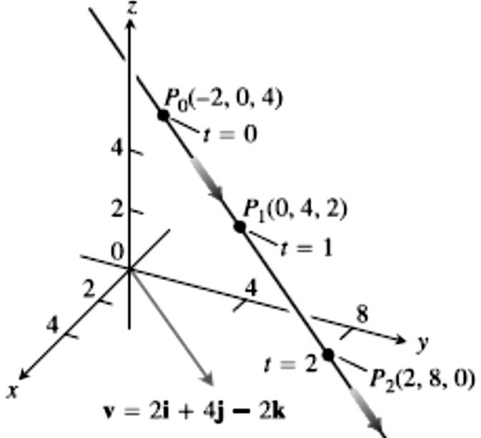
18 / Dep. Of Engineering Mechanics
Class: 2th AMTHMATICS / The vector

Slide 7
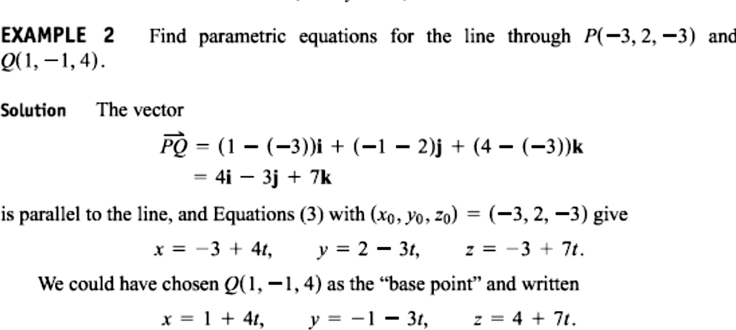
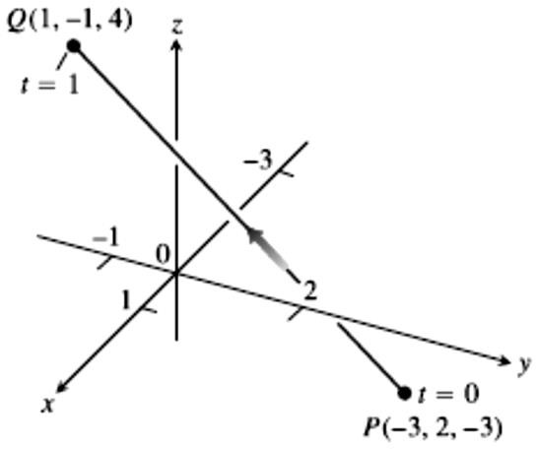
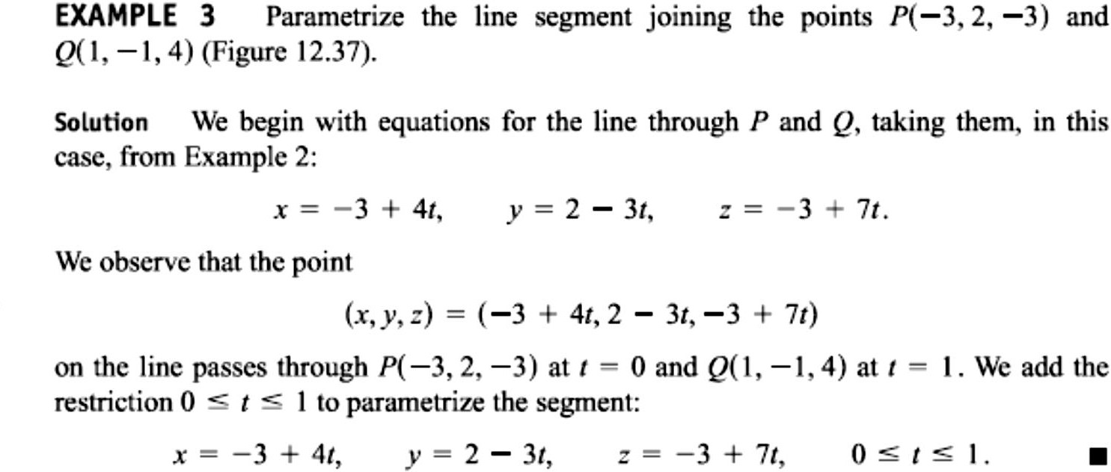
19 / Dep. Of Engineering Mechanics
Class: 2th AMTHMATICS / The vector

